Slide 1

ISOLETTE SOFTWARE SYSTEM
GROUP - 5
RIDDHI PATEL, SNEHIT MIKKILINENI, SHIVAM SHAH
CSE 564: Software Design
Prof. Hessam Sarjoughian

Slide 2
Introduction
The main components of the Isolette that we had to consider for our design are the following: UI/Display, Nurse, Infant, Thermostat, Temperature sensors, Clock and Air.
In design phase specifically, we have considered ways to maintain security of Isolette in terms of maintaining temperature within the safe ranges. This was the main secure functionality which needed to be taken into consideration when constructing the Isolette system.
Also, one of our main points of emphasis in our design and implementation was to have a proper level of modularity. It is important to have different functionalities separate.

Slide 3
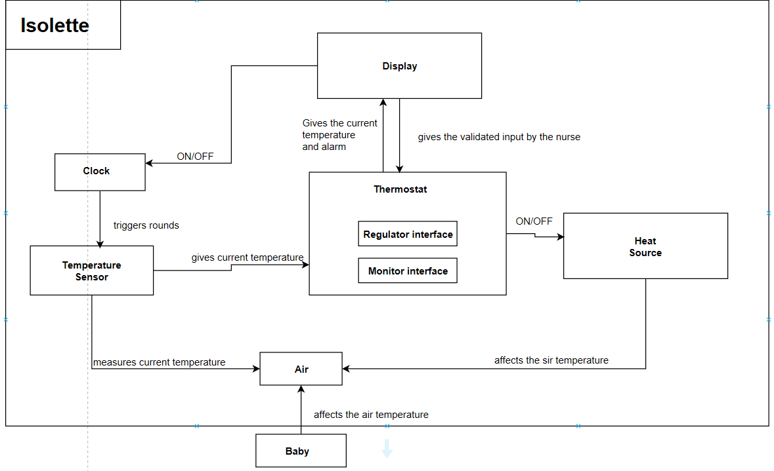
High-Level View

Slide 4
Assumptions
There will be no hardware failures within Isolette system.
There is a time interval of 6 seconds per round in the round-based execution of the components of Isolette.
Initial temperature is read from a file.
When alarm turns On, only the Nurse can turn the Alarm off by responding to it.
When alarm rings, nurse should respond promptly and accordingly.
When alarm rings due to failure in thermostat, the execution of all components is terminated, and when Nurse responds to the alarm, we should start execution again.

Slide 5
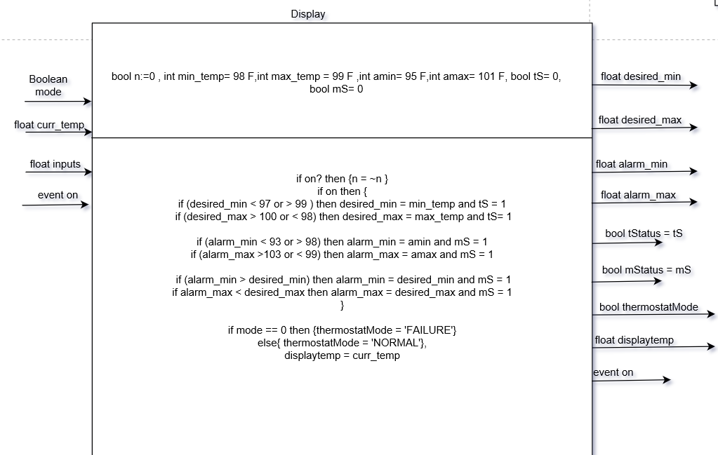
SRC - Display

Slide 6
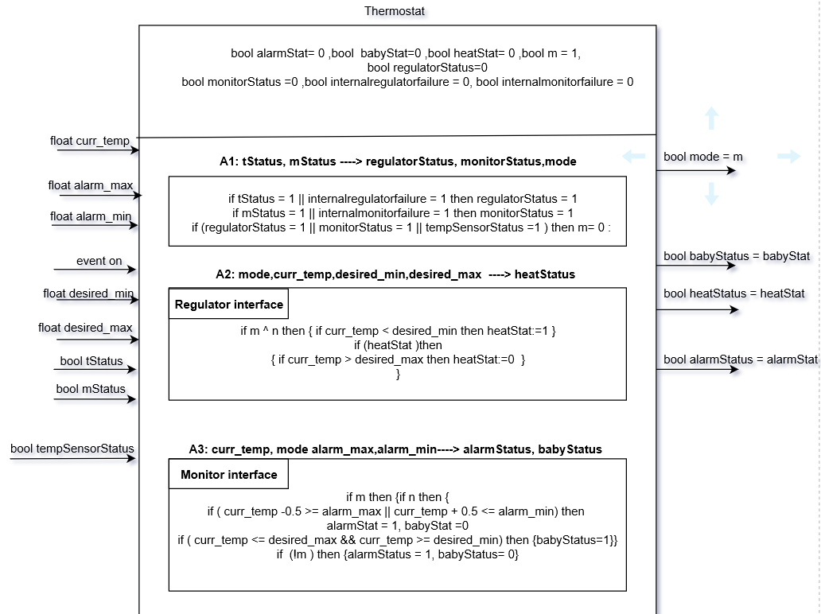
SRC - Thermostat

Slide 7
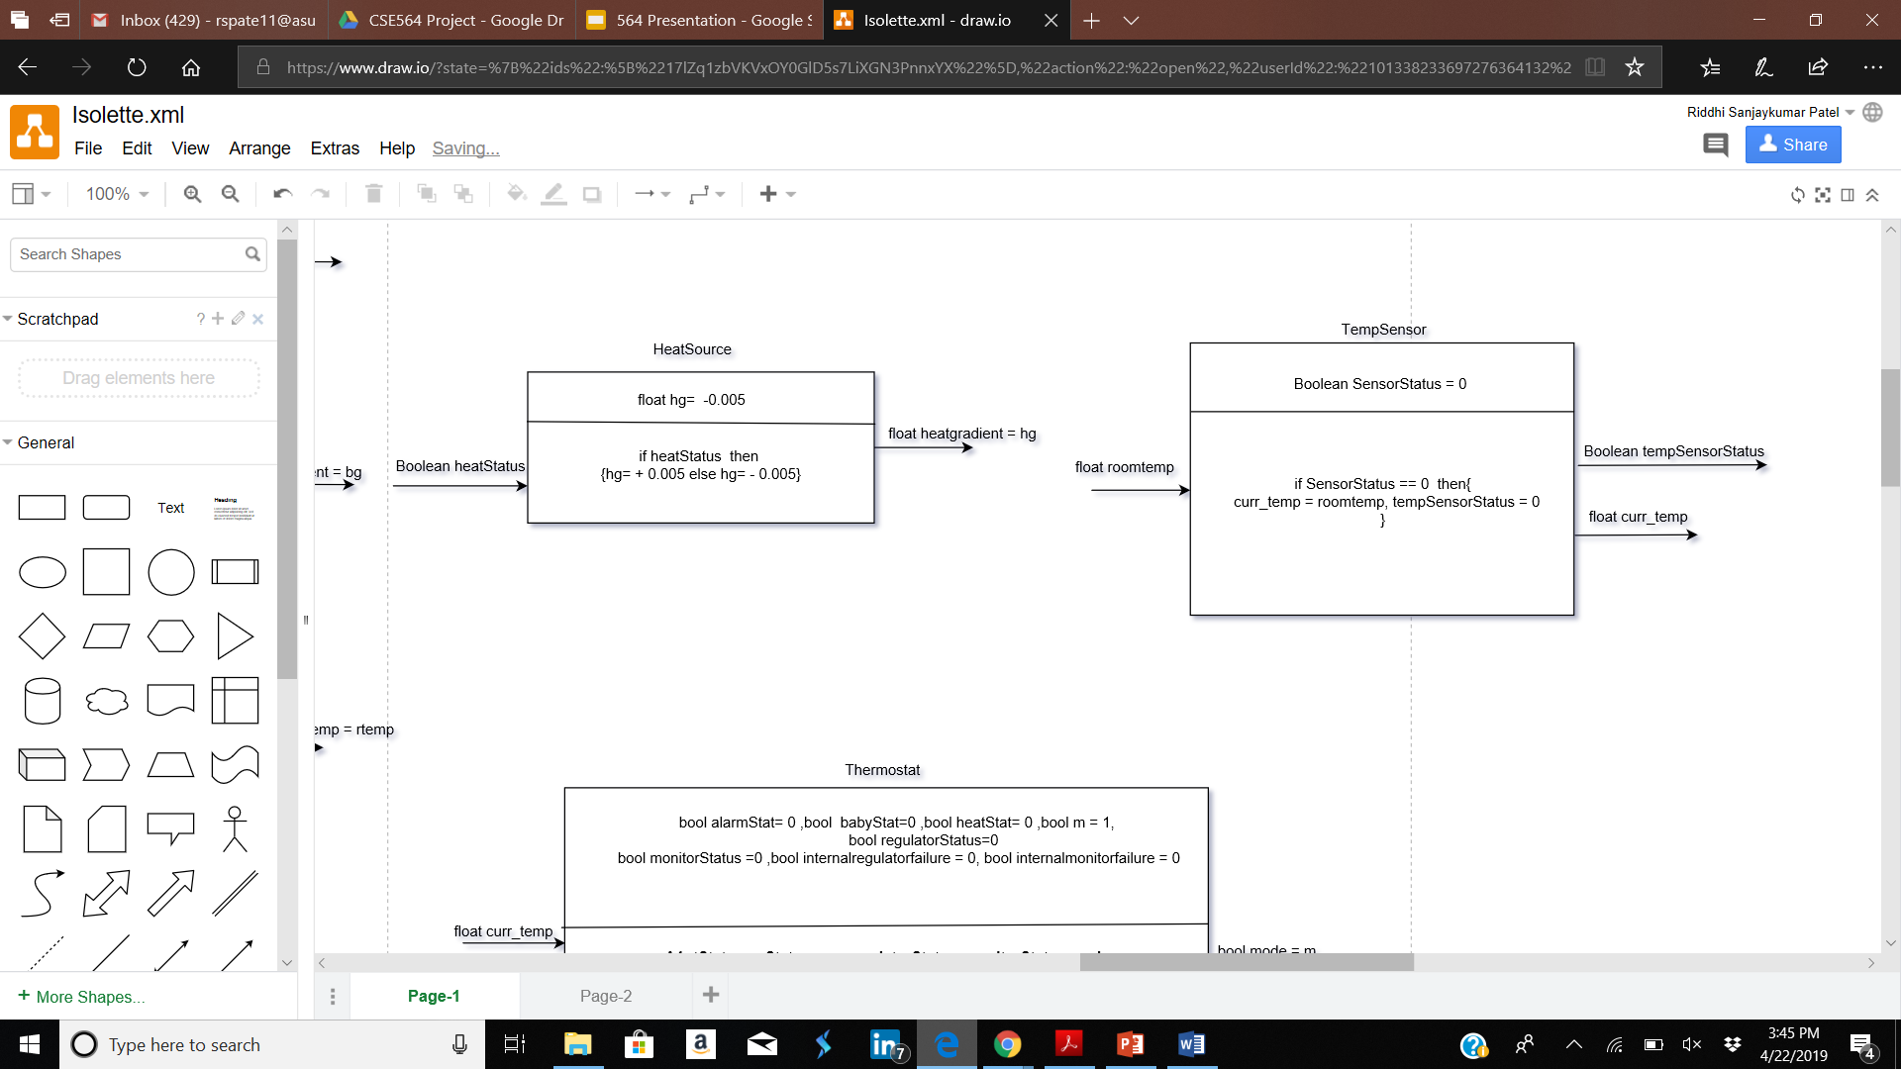
SRC- Heat Source and Temperature Sensor

Slide 8
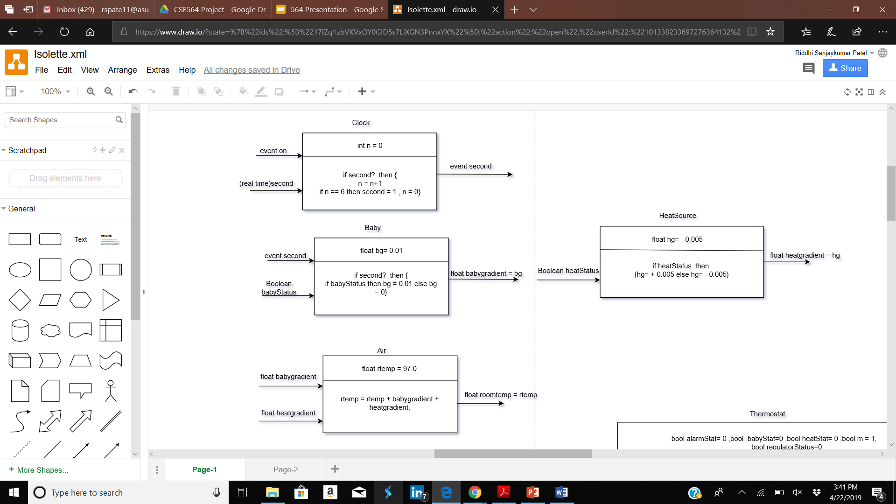
SRC - Air and Baby

Slide 9
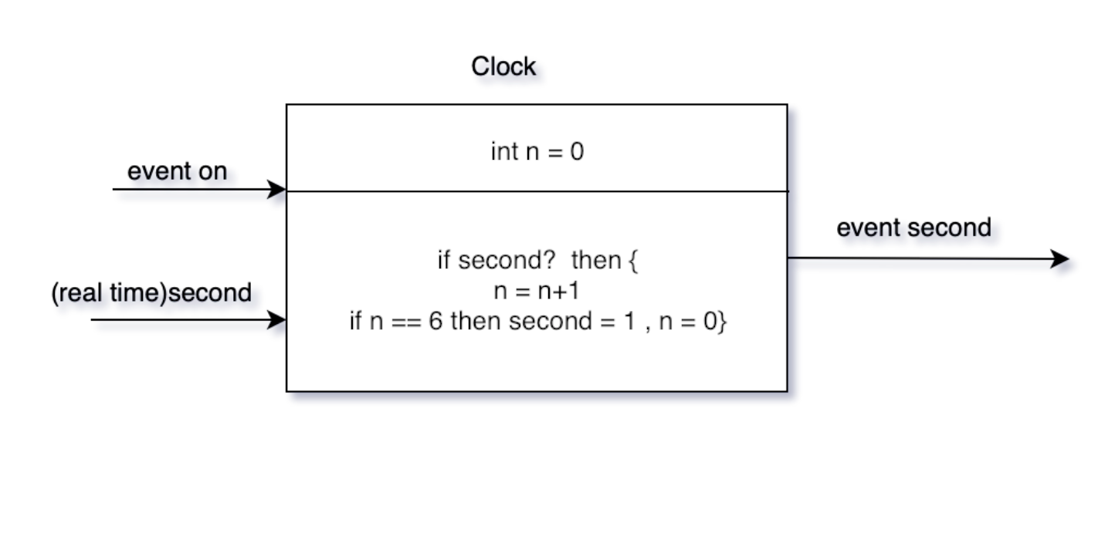
SRC- Clock

Slide 10
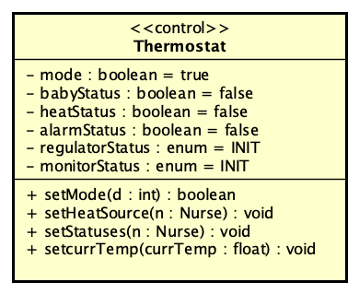
SRC to UML

Slide 11
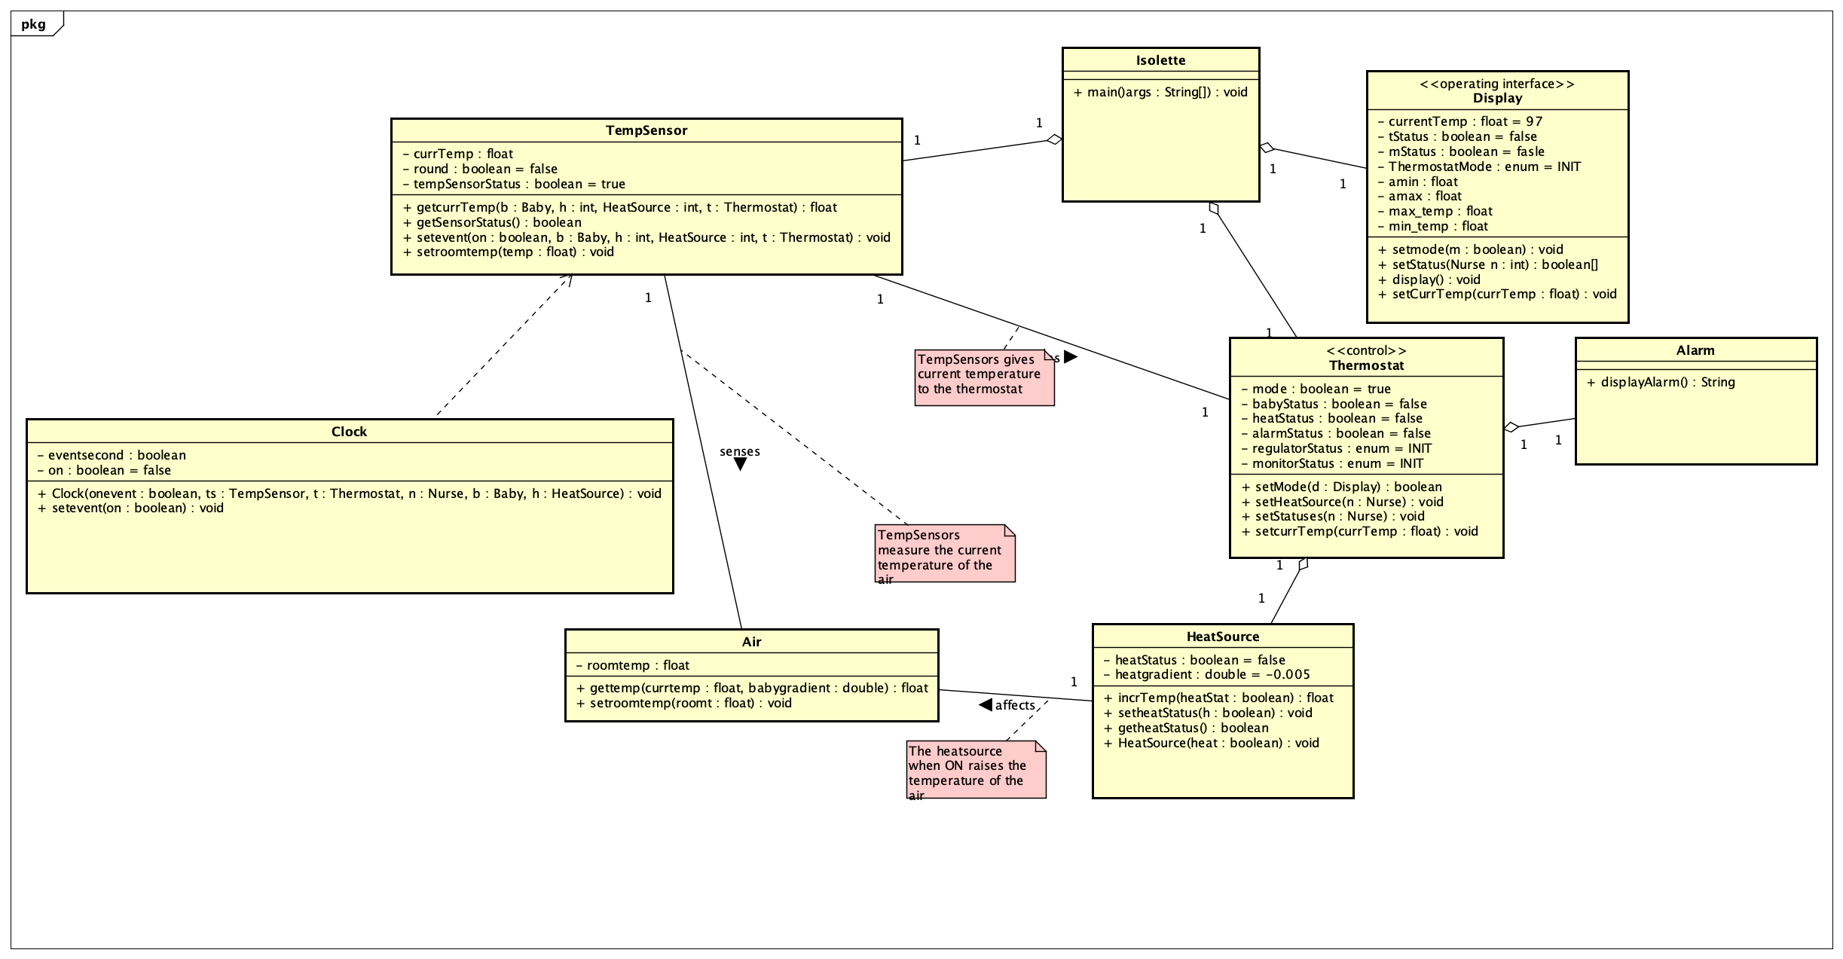
Class Diagram

Slide 12
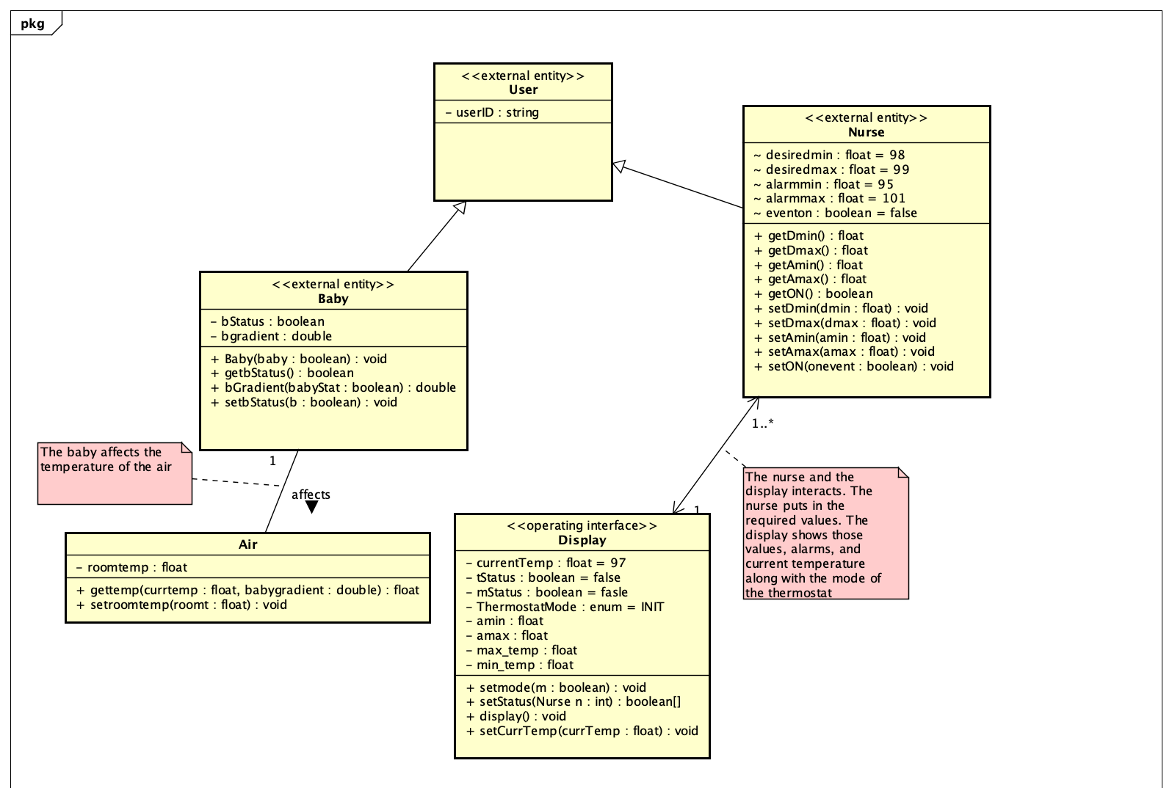
Class Diagram cont.

Slide 13
Implementation
We have set the Isolette class as the class with the main function, which takes console input in order to set the temperature ranges for desired temperature range and alarm temperature ranges. So the entry to the program is in Isolette class.
The flow of the program is such that the Isolette class gets inputs and sets the values of Nurse class. Next, the Isolette class calls upon the Display class in order to configure the settings of Isolette, such as setting its statuses and turning it on.
Then, the flow of the program goes into other classes, such as TempSensor, Thermostat and HeatSource. defined within our clock, we have run these 3 threads.

Slide 14
Implementation cont.
Additionally, the Clock class in our implementation generates the rounds for our program so that there is a round-based execution.
Additionally, in order to incorporate concurrent execution of the Isolette components, we have set up 3 threads. One for Monitor, one for Regulator and one for temperature sensor.
Each of these 3 threads start running within each round. This is done so that there is concurrent execution of the Isolette components within our round-based flow of the program.
We are taking input from the console.

Slide 15
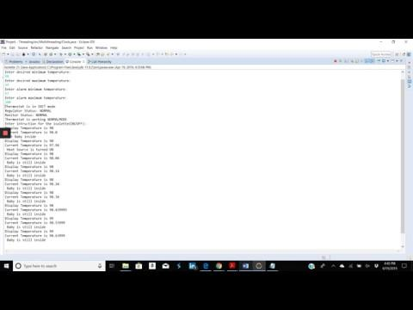

Slide 16
Conclusion - Lessons Learned
We have gained important knowledge about the details of the software design process by way of this project.
We have experience now in developing SRC’s in the design phase of a project, and then being able to transfer that over to the development of UML class diagrams.
Additionally, one other aspect of software design which we has really stood out to us is the amount of details that have to be taken into account, when trying to ensure that requirements and specifications of a desired system are met.

